Slide 1
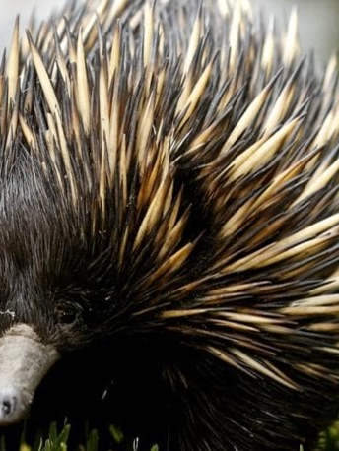
Short-beaked echidna quills
Echidnas are covered in 5cm-long quills for protection. The quills are not projectile or poisonous but very sharp!

