Slide 1
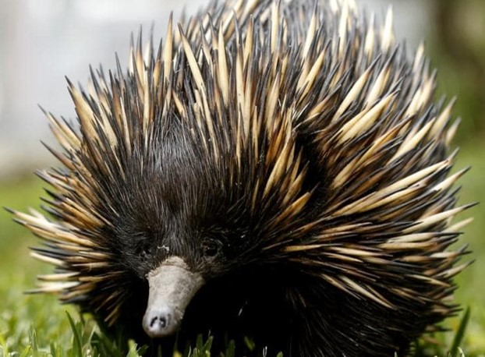
Echidnas are egg laying mammals
Echidna Fun Facts
Echidna quills are modified hairs
Echidnas are solitary except for the breeding season (July – September)
The echidna has a low body temperature (30 - 32 °C / 86 - 90 °F). Body temperature may fall as low as 5 °C /41 °F
The echidna tongue is 17cm or 7 inches long
Echidnas have up to 2,000 electroreceptors on their snouts
Echidnas have backward facing feet for digging

Slide 2
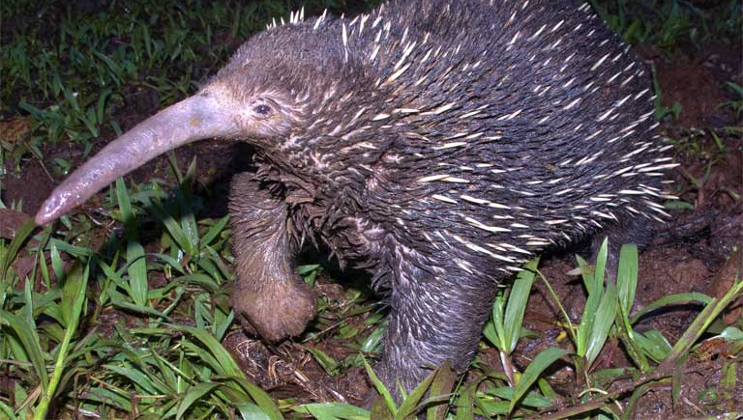
Short-beaked Echidna
Long-beaked Echidna
- Critically endangered
Two types of echidna
Currumbin Wildlife Sanctuary has worked with the University of Queensland over the past 15 years focusing on echidna reproduction. This collaboration will assist with the long-term goal of saving the critically endangered Long-beaked Echidna of Papua New Guinea.

Slide 3
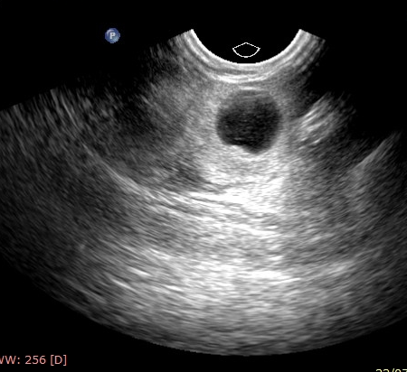
Short-beaked echidna egg
Egg
An egg detected in the echidna uterus
A freshly laid echidna egg
Echidna eggs are roughly the same size as an Australian 5c coin!

Slide 4
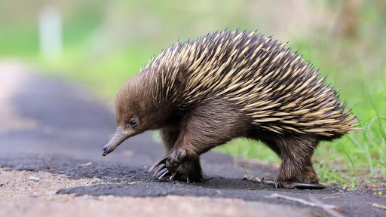
Body covered in sharp quills for protection
Short-beaked echidna anatomy
Ears with no external flaps have excellent hearing
Large brain relative to other mammals
Small eyes with poor vision
Strong snout for foraging and a long, sticky tongue for catching ants and termites
Large claws for digging and tearing open termite mounds
Backwards facing rear feet for digging

